Slide 1
Wardrobe
A Fashion network
Team 3
Junwei Peng
Kavya Ravavarapu
Lama Mukhtar
Saurabh Katariya
Zhou Liheng
Notes:
Lama

Slide 2
Elevator Pitch
Not sure what clothes to pack up for your trip to Iceland next week?
Have you worn the wrong suit for an interview?
Not to worry, because Wardrobe application is here to help you dress properly for any event through community-drawn advices. Not only that, but providing information on the current trends for your premium users would be a piece of cake.

Slide 3
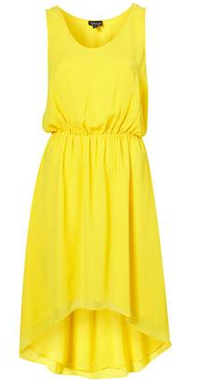
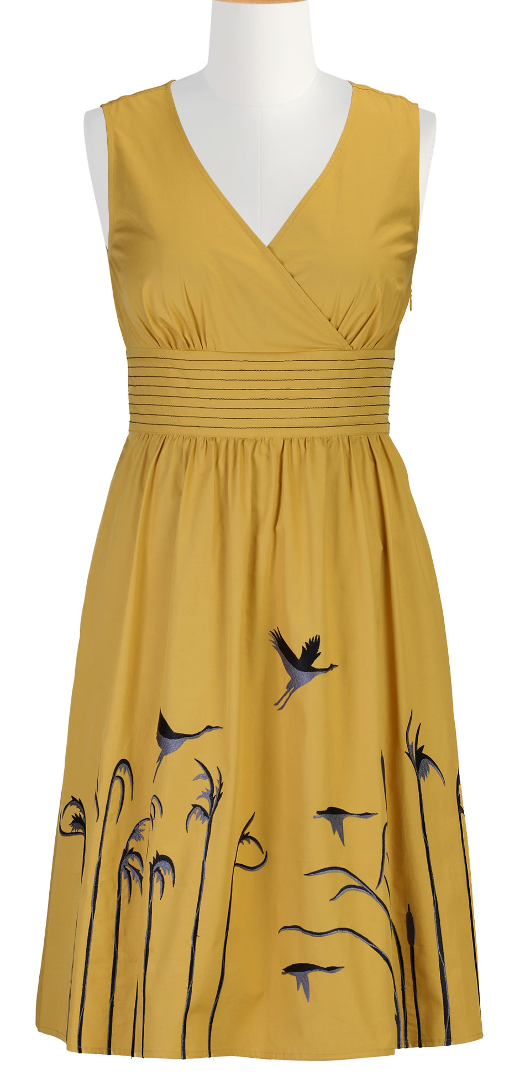
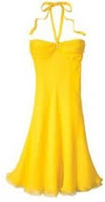
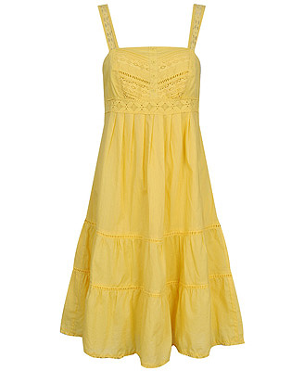

Problem Scenario
Scenario1
Dina and Sam are married for 5 years now
They are planning a birthday party for their 3 year-old son at their back yard
She can’t decide which yellow dress to wear and asks her
husband
Husband:“Honey, you look great” (Not enough!)
Scenario2
Jeremy Gilbert’s best friend, Ajit, just passed away
In preparation for the funeral, Jeremy whips up a black suit with matching shoes, and a tie over his white shirt
He gets to the funeral and ...

Slide 4




Oops!
Oops!
Oops!
Oops!
Oops!
Oops!
Notes:
Jeremy showed up at an Indian funeral where everyone wore white overalls.

Slide 5



Problem Statement
There is a need to know the right outfit to wear for events wherever a person is located
Notes:
Including the right weather

Slide 6
Solution Statement
Develop a social network website and app majoring in the fashion field which enables the users to share their dressing ideas and recieve recommendations
Notes:
The current fashion trend is limited to a small group of people.
People who thought they got a talent on fashion or good taste need a platform to show their ideas.
Regular users: want to know what to wear.
Enterprise user: busineess intelligence data analysis: trends for the year; age.

Slide 7
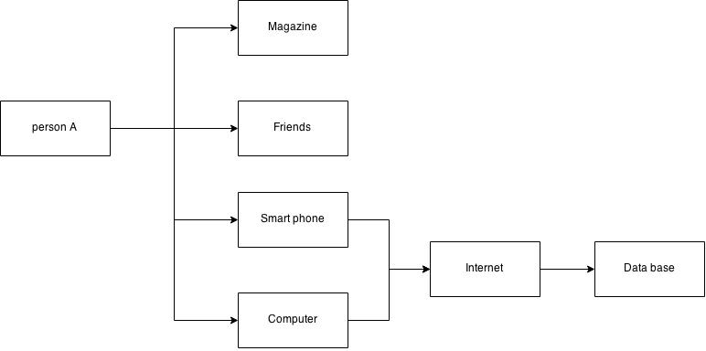
Current Structure Diagram
For Regular users

Slide 8
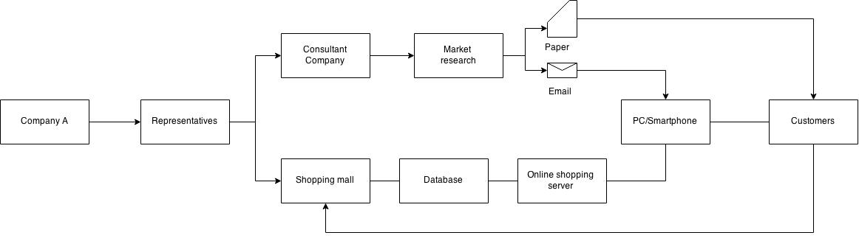
Current Structure Diagram
For Enterprise users

Slide 9
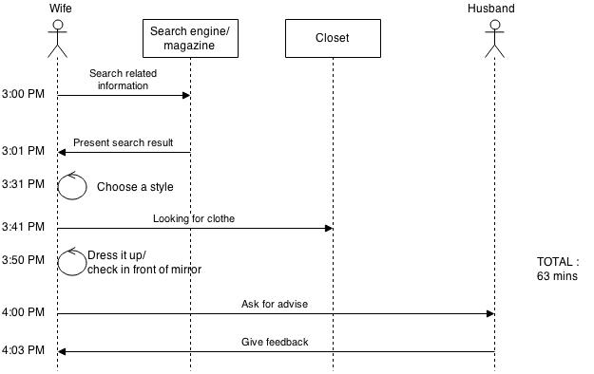
Current Sequence Diagram (Scenario 1)
Total :
80 min
Loop 3 times

Slide 10
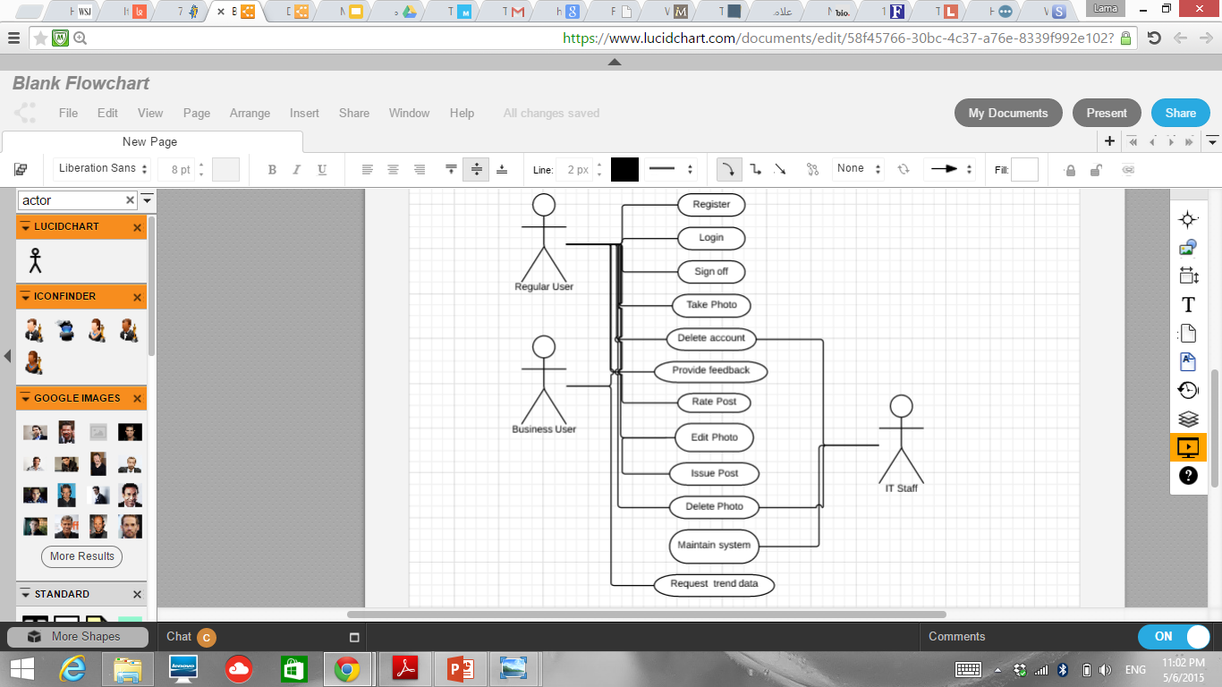
Solution: Use Case Diagram

Slide 11
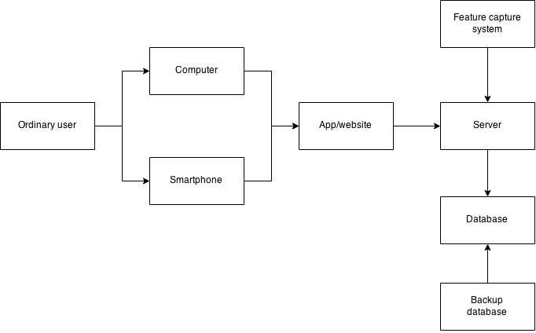
Solution: Structure Diagram
For Regular users

Slide 12
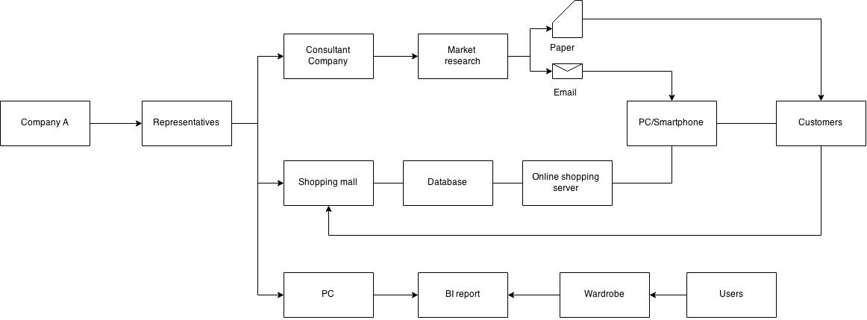
Solution: Structure Diagram
For Enterprise users

Slide 13
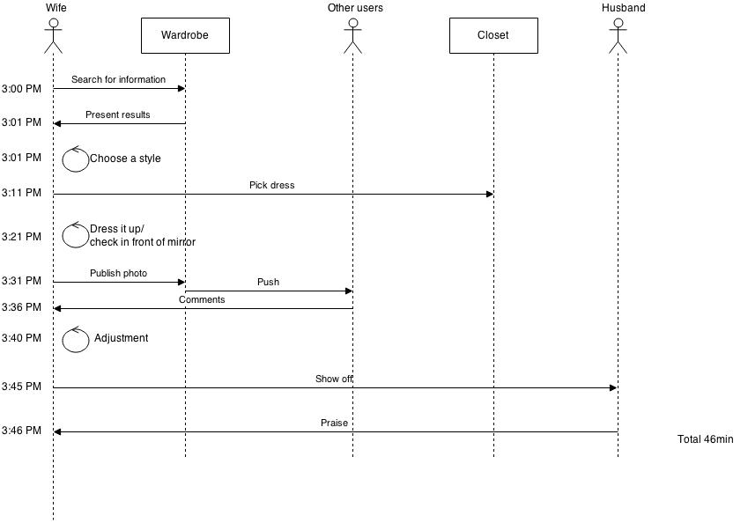
Solution: Sequence Diagram (Scenario1)
.

Slide 14
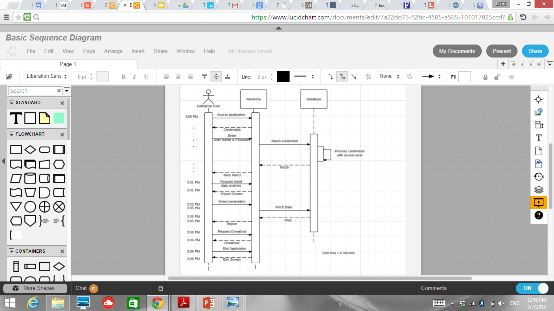
Solution: Sequence Diagram
Notes:
Enterprise User

Slide 15

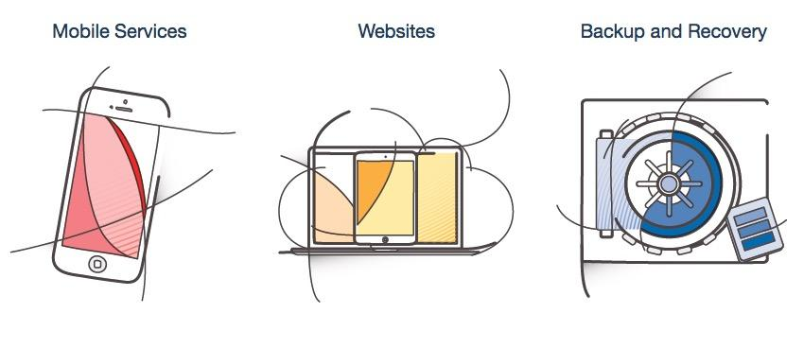
Technology Enabler

Slide 16

Convolutional Neural Network
Convolutional Neural Network is used in image recognition system. It has achieved an error rate of 0.23 percent in the MNIST database.

Slide 17
Convolutional Neural Network
The CNN is a machine learning network, it will consume time for the network to learn features. The network developement is decomposed as three phases.
Phase1 :Four months to build the network(programing)
Phase2 :Four months to learn from patterns
Phase3: Four months of beta test(Sample test)

Slide 18
Prototype

Slide 19
How to sign up for it ?
Download the application/open website
Create a profile using an E-mail ID and log in to add your details
Add your friends and peers that you would appreciate reviewing your clothes
Set privacy settings
That’s it!

Slide 20
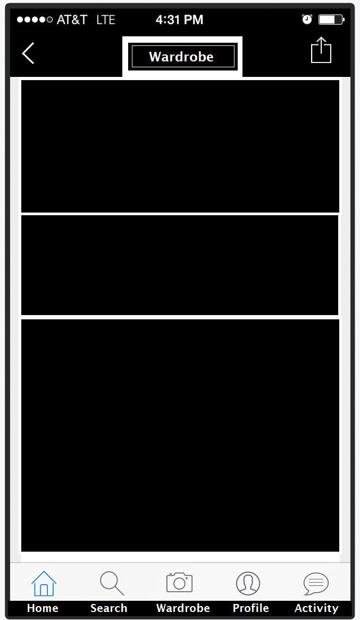













Home Screen
Kavya Ravavarapu
Lives In New Jersey Hometown Hyderabad,India
USER PROFILE
Name
Body type
Height
Interests – defines the kind of clothes the person likes
LIKES
User can like the profiles of all the fashion designers and fashion chains that he/she likes
Use Home, search, wardrobe Profile icons to navigate
Body type : Pear
Height : 5’ 9”
Interests : Indian, Hindu, Skirts, Dresses, Jumpsuits
LIKES

Slide 21
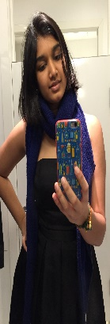
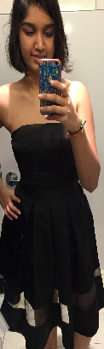

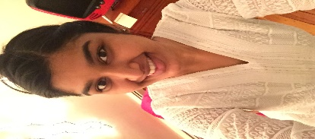
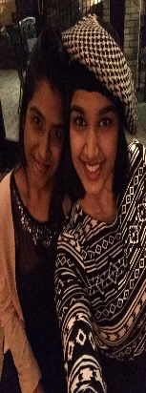
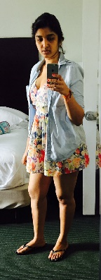
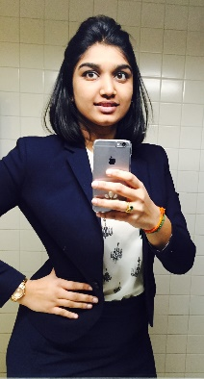
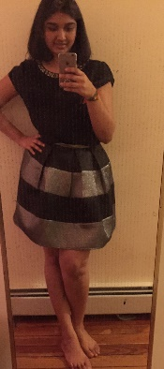
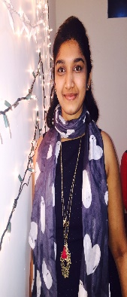
Wardrobe
Wardrobe
Add photos of yourself in your outfit to get peer’s opinion
Photos can be added from the phone
Upload photos using the link at the bottom
Upload Photos

Slide 22
Scenario 1
I am going to the Night at the Races event which is a polo match in New York city. I know for a fact that I need to look dressy with a hat and cocktail dress.
How do I dress up?

Slide 23

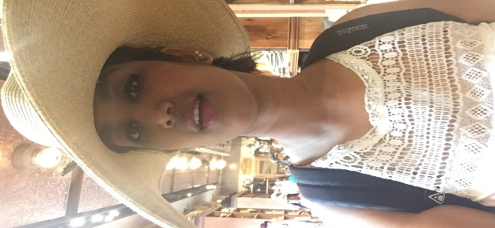
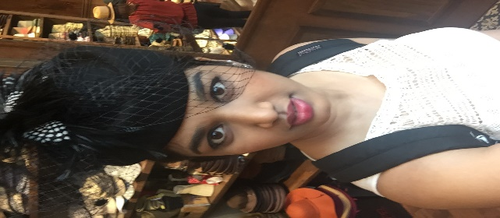
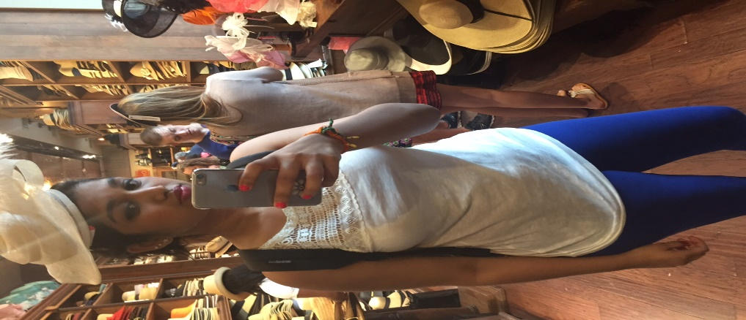


Upload photos
Add a caption that conveys requirement
Tag the event that you are attending
Wardrobe will update the weather prediction for that day according to location
Friends will leave their suggestions to help you with the situation
Pick a hat!
Dress Cocktail
Event Night at the Races
Climate at New York 21c with chance of mild showers
Leave a comment

Slide 24
Scenario 2
Its Summer! I need to find the right pair of shades that are trending this season.
How do I pick a pair ?
Of course, I go to Sunglasshut to try the latest releases for this season.
What if I am unable to choose between two pairs of shades?

Slide 25
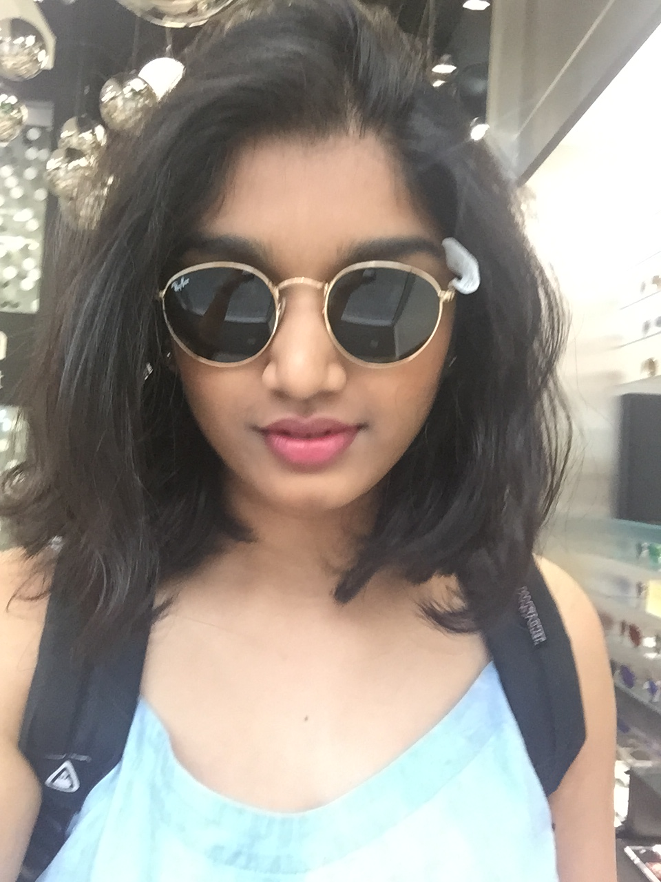
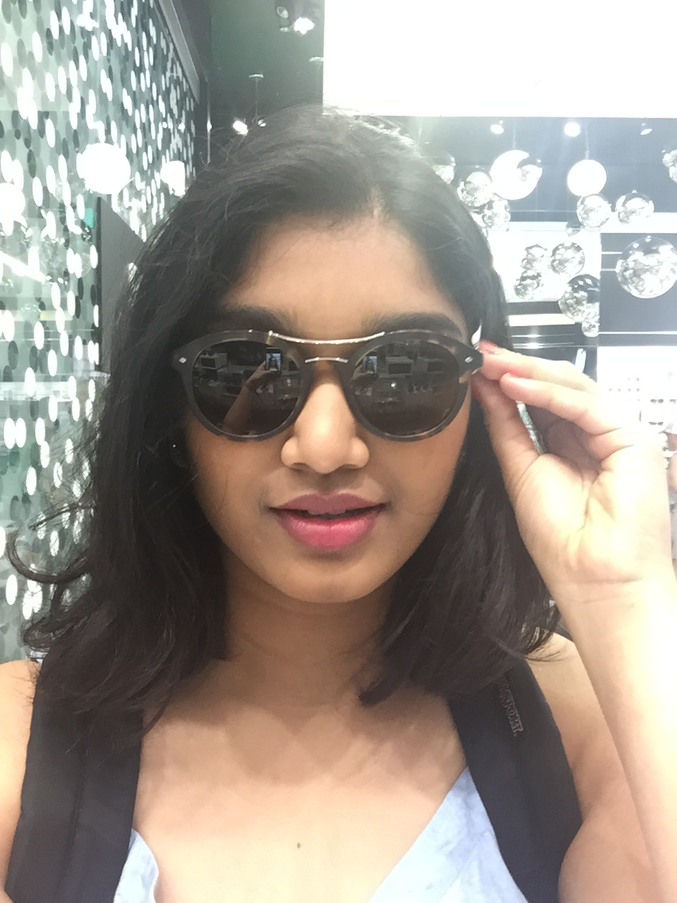
Push notifications
If only, I had Wardrobe
Add a caption to convey your requirement
Tag the event that you are going to
Select a set of peers that should see the picture and react at the earliest
Shades for Summer’15
Push Notifications
X
Michael frank
Leave a comment
X
Zhou Liheng
junwei peng
Saurabh Katariya
X
Lama Mukhtar

Slide 26
Extra Features
Trend based on voting - where the highest voted pictures will be trending through the network
Shop the outfits you like by clicking on the piece of costume
Scenario - if you like a pair of shoes that a model is wearing, just click on it to navigate to the shopping site
Bussiness view - greatly leverage fashion market by providing a common platform for fashionista’s-to-stylists-to-naive audience

Slide 27
Cost Analysis
Labor cost | Salary | Num | Total
Project Manager | $96,425/year | 1 | $ 96,425.00
IOS APP develop Engineer | $86,241/year | 2 | $ 172,482.00
Android APP develop Engineer | $87,742/year | 2 | $ 175,484.00
Computer vision Engineer | $87,626/year | 1 | $ 87,626.00
Database Engineer | $60,900/year | 1 | $ 60,900.00
Testing Engineer | $74,331/year | 1 | $ 74,331.00
UI designer | $74,713/year | 1 | $ 74,713.00
Web engineer | $82,730/year | 1 | $ 83,730.00
Stylist | $31,897/year | 5 | $ 159,485.00
Total Labor cost |  | 15 | $ 985,176.00
All the data comes from website
”www.glassdoor.com”
And we chose national average as our numbers.
Notes:
Liheng

Slide 28
Cost Analysis
We choose to rent servers from Amazon’s web service;
Instance Type | API Name | Memory | Virtual Cores | ECU ª | Storage | Arch | I/O | OS
Standard L | m1.large | 7.5 GB | 2 | 2/core | 850 GB | 64 | High | Linux/Unix/Windows
Server cost(rent) | Price
Target customer number | 1,000,000
Server quantity | 100+
Server unit price | $0.052/hour
Server cost | $45,552/year

Slide 29
Cost Analysis
Other cost | Price
House rent | $60,000/year
Hardware(PC) | $1,000/person
electricity | $2,000/year
Insurance&Warranties | $1,000/year
Back up&recovery(50TB;Amazon) | $14,160/year
Software License(IDE,System,DB) | $500/person
Operation infrastructure | $6,000
Security Breaches(ADT&Mcafee) | ($1,500+$1,000)/year
Training | $1,000/person
Total other cost | $123,160

Slide 30
Revenue Analysis
Ads Revenue
(TC)Target customer number in one year | 1,000,000
MAU(Monthly Active Users) | 80% of TC
DAU(Daily Active Users) | 50% of MAU
Average user using time | 3600s
Ads Banner change frequency | 60S
Average Banner click ratio | 0.20%
Every click’s revenue | $0.10
Daily Revenue | $4,800
Monthly Revenue | $ 144,000
We are assuming that after we publish our application, the customer number will have a linear growth to 1 million within the first year.

Slide 31
Break-Even Point
Time | Y1Q1 | Y1Q2 | Y1Q3 | Y1Q4
Revenue | 0 | 0 | 0 | 0
Cost | $940903.00
Net Profit | O | 0 | 0 | ($1152888.00)
Investment | $1,500,000.00 | 0 | 0 | 0
Y2Q1 | Y2Q2 | Y2Q3 | Y2Q4
$144,000.00 | $288,000.00 | $432,000.00 | $576,000.00
$302,468.00 | $302,468.00 | $302,468.00 | $302,468.00
($158,468.00) | ($14,468.00) | $129,532.00 | $273,532.00
0 | 0 | 0 | 0
Time | Y3Q1 | Y3Q2 | Y3Q3 | Y3Q4
Revenue | $576,000.00 | $576,000.00 | $576,000.00 | $576,000.00
Cost | $302,468.00 | $302,468.00 | $302,468.00 | $302,468.00
Net Profit | $273,532.00 | $273,532.00 | $273,532.00 | $273,532.00
Investment | 0 | 0 | 0 | 0
The Break Even point= Fixed Cost/(Revenue-Variable Cost)+Develop time~3 years ROI= Net profit/ Investment=11.4%

Slide 32
Metrics of Success
Tangible:
Break even point would be 3 years.
ROI > 20%
Accuracy of feature capture system > 95%
Customer Number > 1 Million
Non-Tangible:
Positive customer feedback is >70%
Ease of use/user-friendliness is rated positive >70%
Application usage by 70% in first year.
Retaining 90% of existing customers on the 4th year.
Notes:
http://www.statista.com/statistics/264810/number-of-monthly-active-facebook-users-worldwide/
1.44 billion monthly active users of facebook.

Slide 33
Specs / Rules
Location: shows weather
Dress Restrictions: cultural, religious, personal
Hight/weight/body type
Response Speed level (button): based on event time. Push Notification
Updates if someone changed clothes
Filtering to: Private (friends), Public

Slide 34
Phases - Revenue Generation
Ads from local stores
Ads from bigger stores
Premium accounts: enterprise account for analysis results (with the added feature)
Notes:
Based on location

Slide 35
Phases - Product Development
Application And Website
Beta Version
Customised advice for premium users

Slide 36
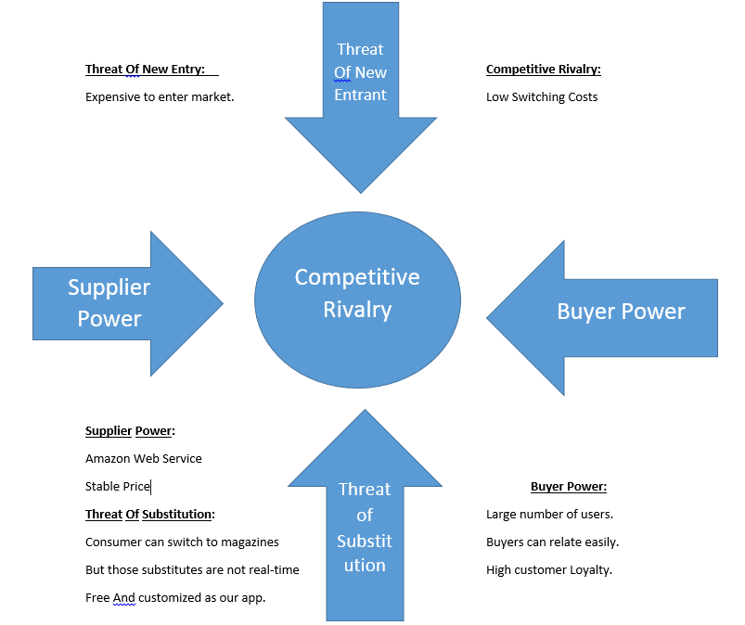
Porter Five Forces Analysis

Slide 37
Benefits
No public embarrassmment
Determine spouse’s true opinion
Be confident
Learn from the advice and other’s experience
Be a part of new culture/group easily
Be preplanned for all the trips to new places
Be comfortable in all types of weather
Potential job opportunity
Notes:
Saurabh

Slide 38
Future scope
Users can subscribe to the Magazine by paying lesser than they pay to get a physical copy delivered at your doorstep
Subscribe to various designers and stylists varying from an intern-to-level 3 stylist to help pick the right dress choices by creating a wardrobe that reflects your real life wardrobe
1. Add everything that you add to you wardrobe bin
2. Your Stylists will help you club the right outfits/accessories/shoes

Slide 39
Future scope
Sign-up for a stylist
1. Anyone can be a stylist
2. Person without a fashion degree can only join as intern Stylist and gradually improve their levels
Designers and Stylists in the fashion industry can sign-up as a stylist provided our team accepts their application
Trend the deals that are currently in market with AI and Business analytics help

Slide 40
Alternative solution
Wardrobe’s Goal – help users learn to dress appropriately to occasions and places
To attain perfection to Wardrobe’s goal we present our user with more professional styling
Add stylists – Only fashion students, professional stylists, designers
Levels of stylists – Intern, Stylist 1, Stylist 2, Master Stylist

Slide 41
Alternative solution
Disadvantages
More of a styling platform rather than social network – Professional stylists will be only be available
Expensive model – Need to pay a minimum sign up fee
Less users as the expenses are higher
Slow – response wont be as quick as solution 1 as there would be one or two stylists alone who will need time to review
Cant work for Scenario 2 where you need advice while shopping

Slide 42
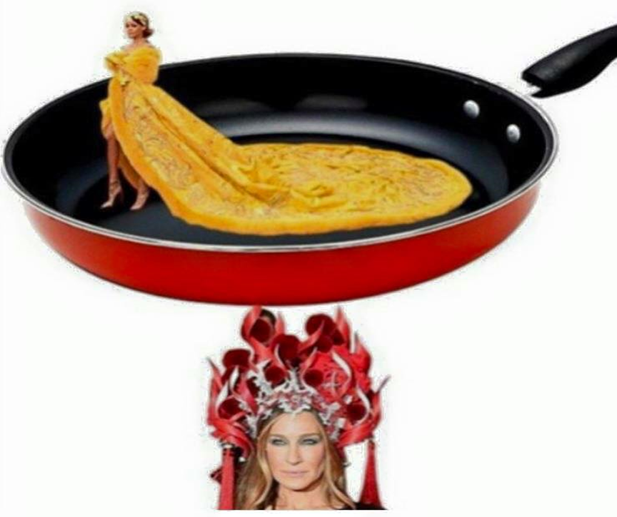
Wardrobe
With this kind of fashion
network,
there is no chance
to get roasted like one of them

Slide 43
Thank you !

